Slide 1

Women's Clothing E-Commerce Reviews
Maryam Heidari
Winter 2019

Slide 2

Questions
1. The Distribution of age of people
2. The distribution of rating
3. Proportion of recommended to not recommended
4. Crosstab plot for Age and Rating, Is the age of people have impact on their rating?
5. the average rating for each Clothing ID
6. Finding Clothing ID with low rating mean and report their ID to strategy group so they can make decision about it.

Slide 3
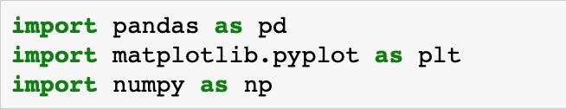
Before I start anything on python I import Some packages that I am going to use:

Slide 4
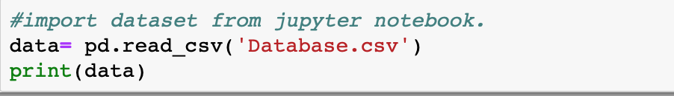
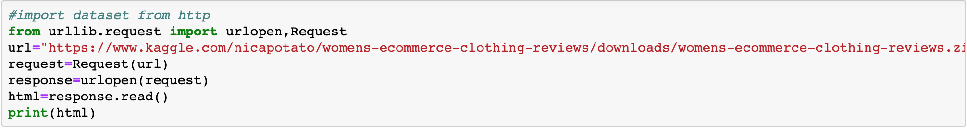
Open the file
Upload on Juypter notebook
From on-line source

Slide 5
Describe Data Set
print(data.head())
print(data.tail())
print(data.columns)
print(data.shape)
print(data.info())
print(data.describe())

Slide 6
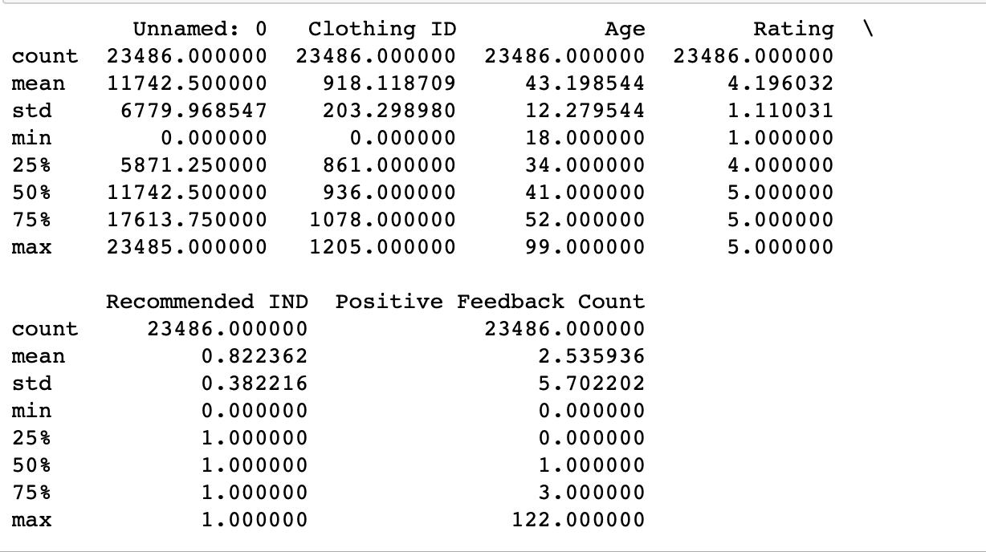
Rows : 23486
Columns : 11
Columns names: Clothing ID, Age, Title, Review Text, Rating, Recommended IND, Positive feedback count, Division name, Department name , Class name

Slide 7
finding missing data
#total number of NaN
print(data.isnull().sum())
# deleting null or missing data values
data.dropna()

Slide 8
In order to make my work easier
df= data.rename(index=str,columns={"Recommended IND":"Recom", "Clothing ID":"ID", "Review Text":"Review"})
Df= df.loc[:,["ID","Review","Recom","Age","Rating"]]

Slide 9
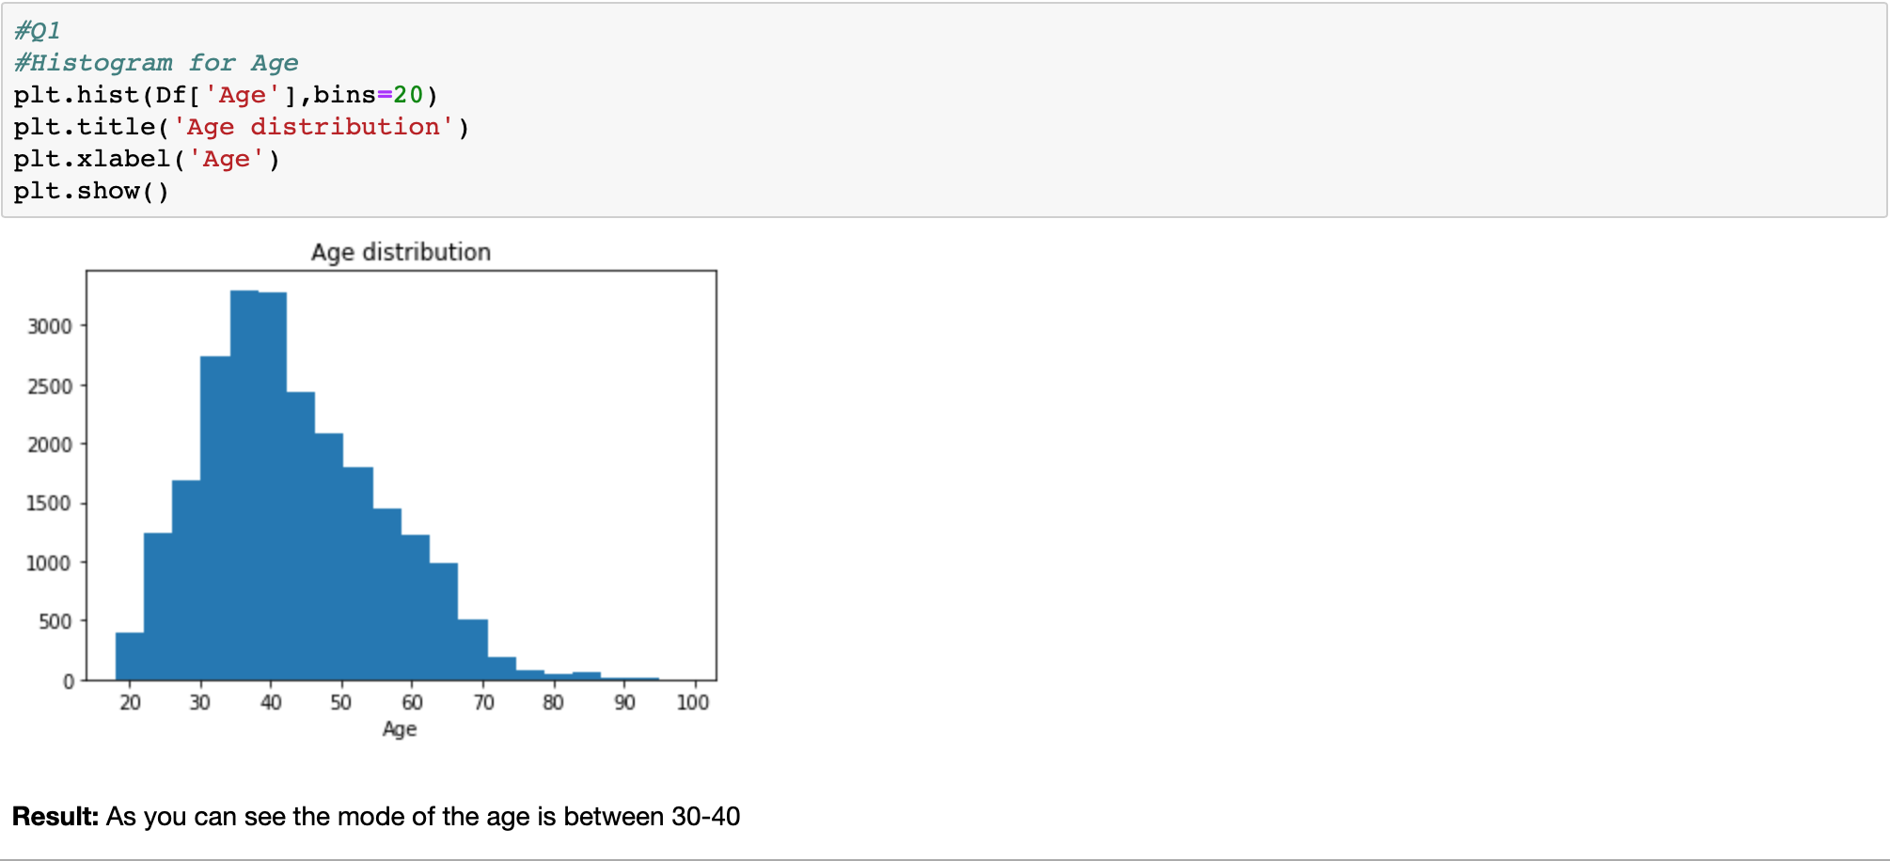
Question1: The Distribution of age of people

Slide 10
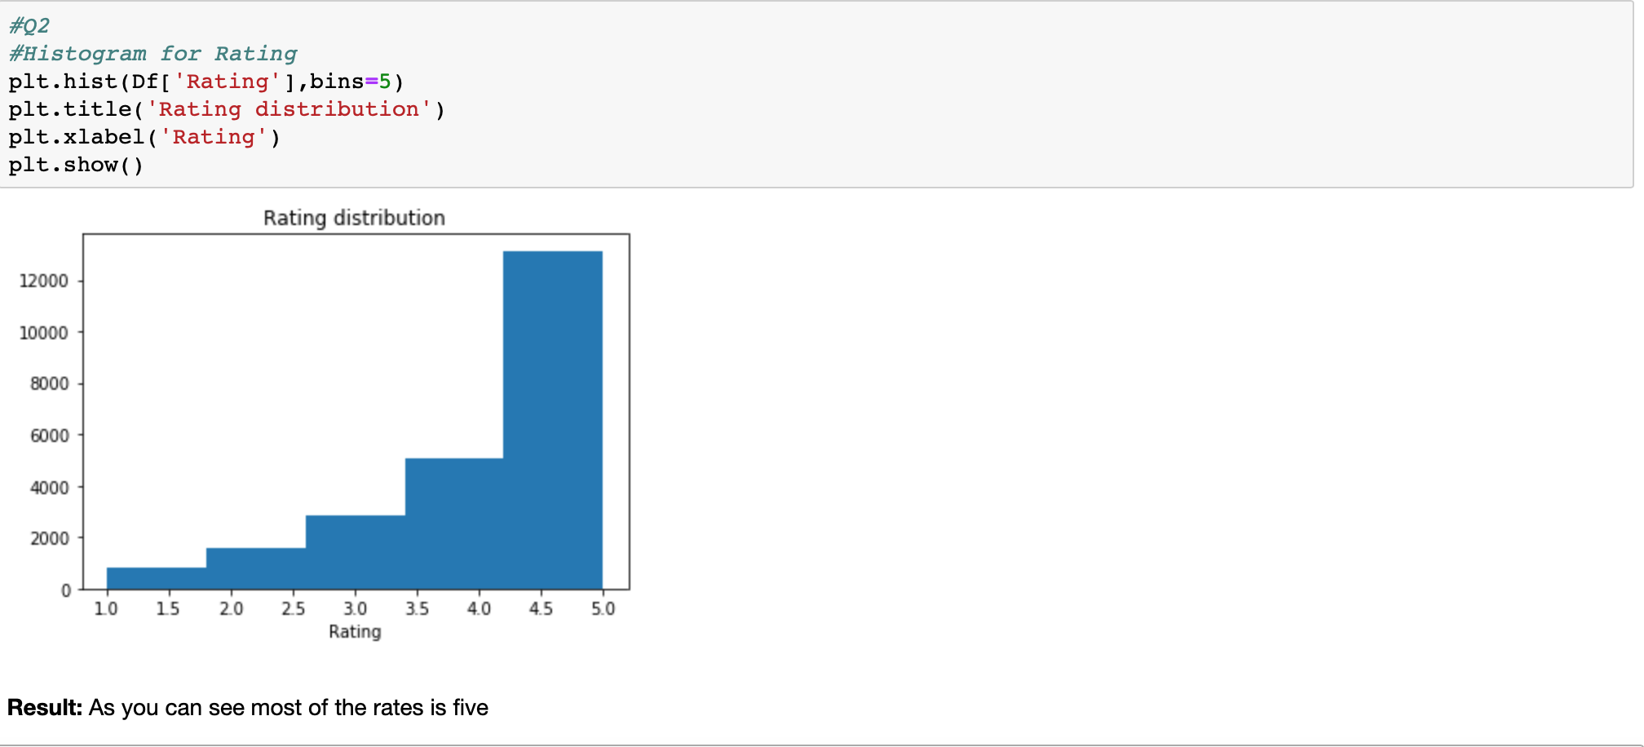
Question 2: The distribution of rating

Slide 11
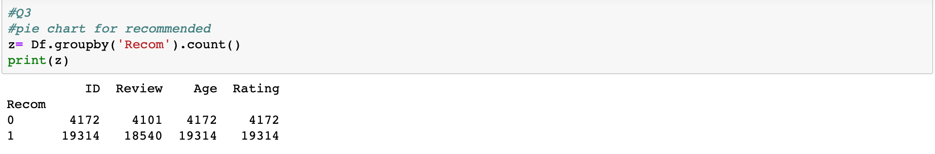
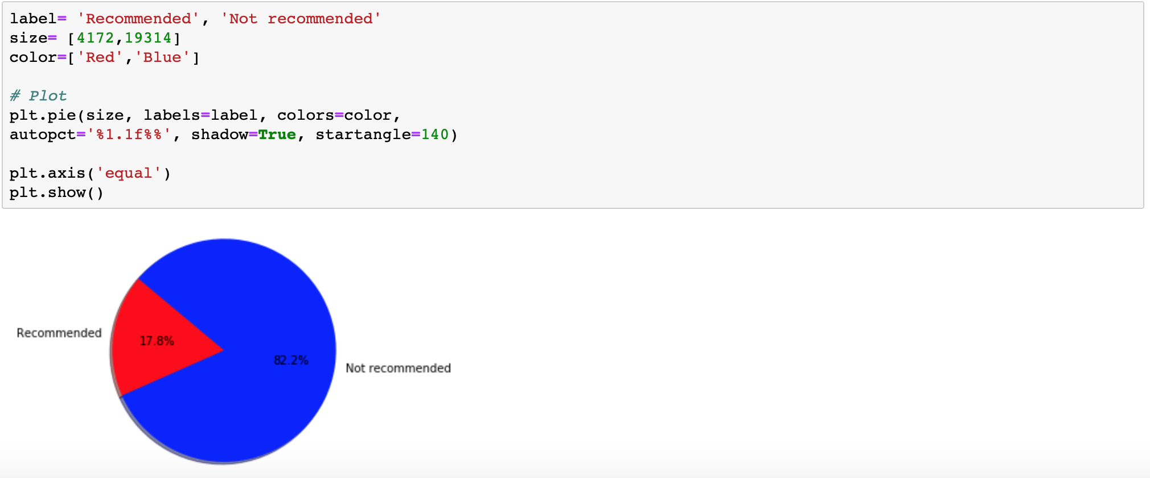
Question 3 : Proportion of recommended to not recommended

Slide 12
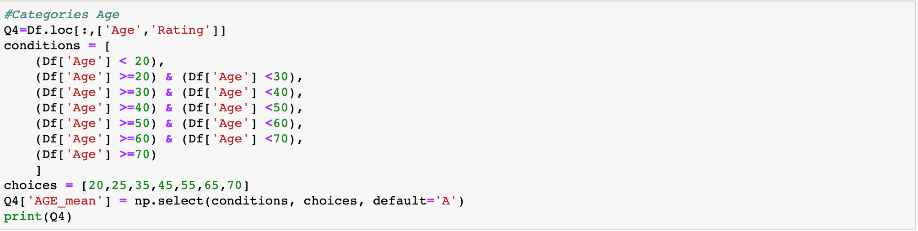
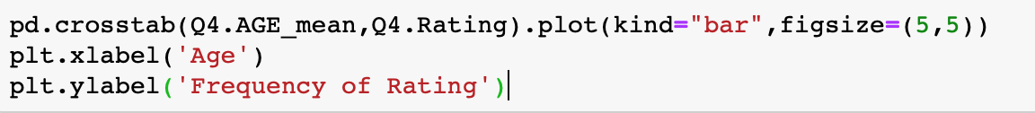
Question 4 : Crosstab plot for Age and Rating, Is the age of people have impact on their rating?

Slide 13
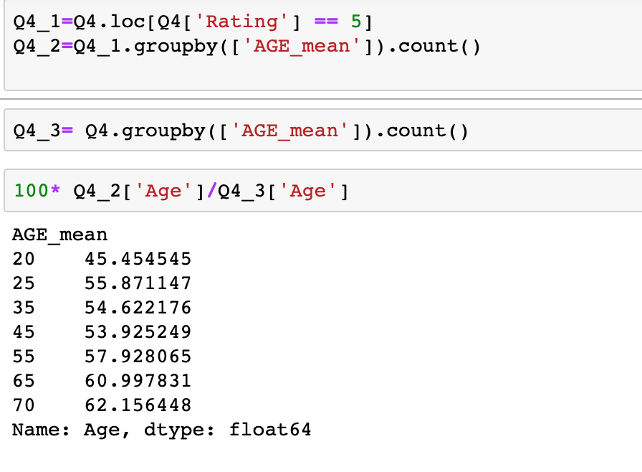
As result, we can see as customers’ age goes up the percentage of the people how give the 5 to the clothes is goes up. So, it is easier to please the older woman than younger one

Slide 14
Question 5 : the average rating for each Clothing ID

Slide 15
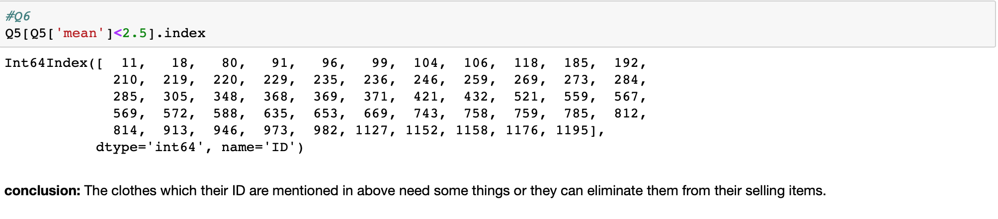
Question 6 : Finding Clothing ID with low rating mean and report their ID to strategy group so they can make decision about it.

Slide 16
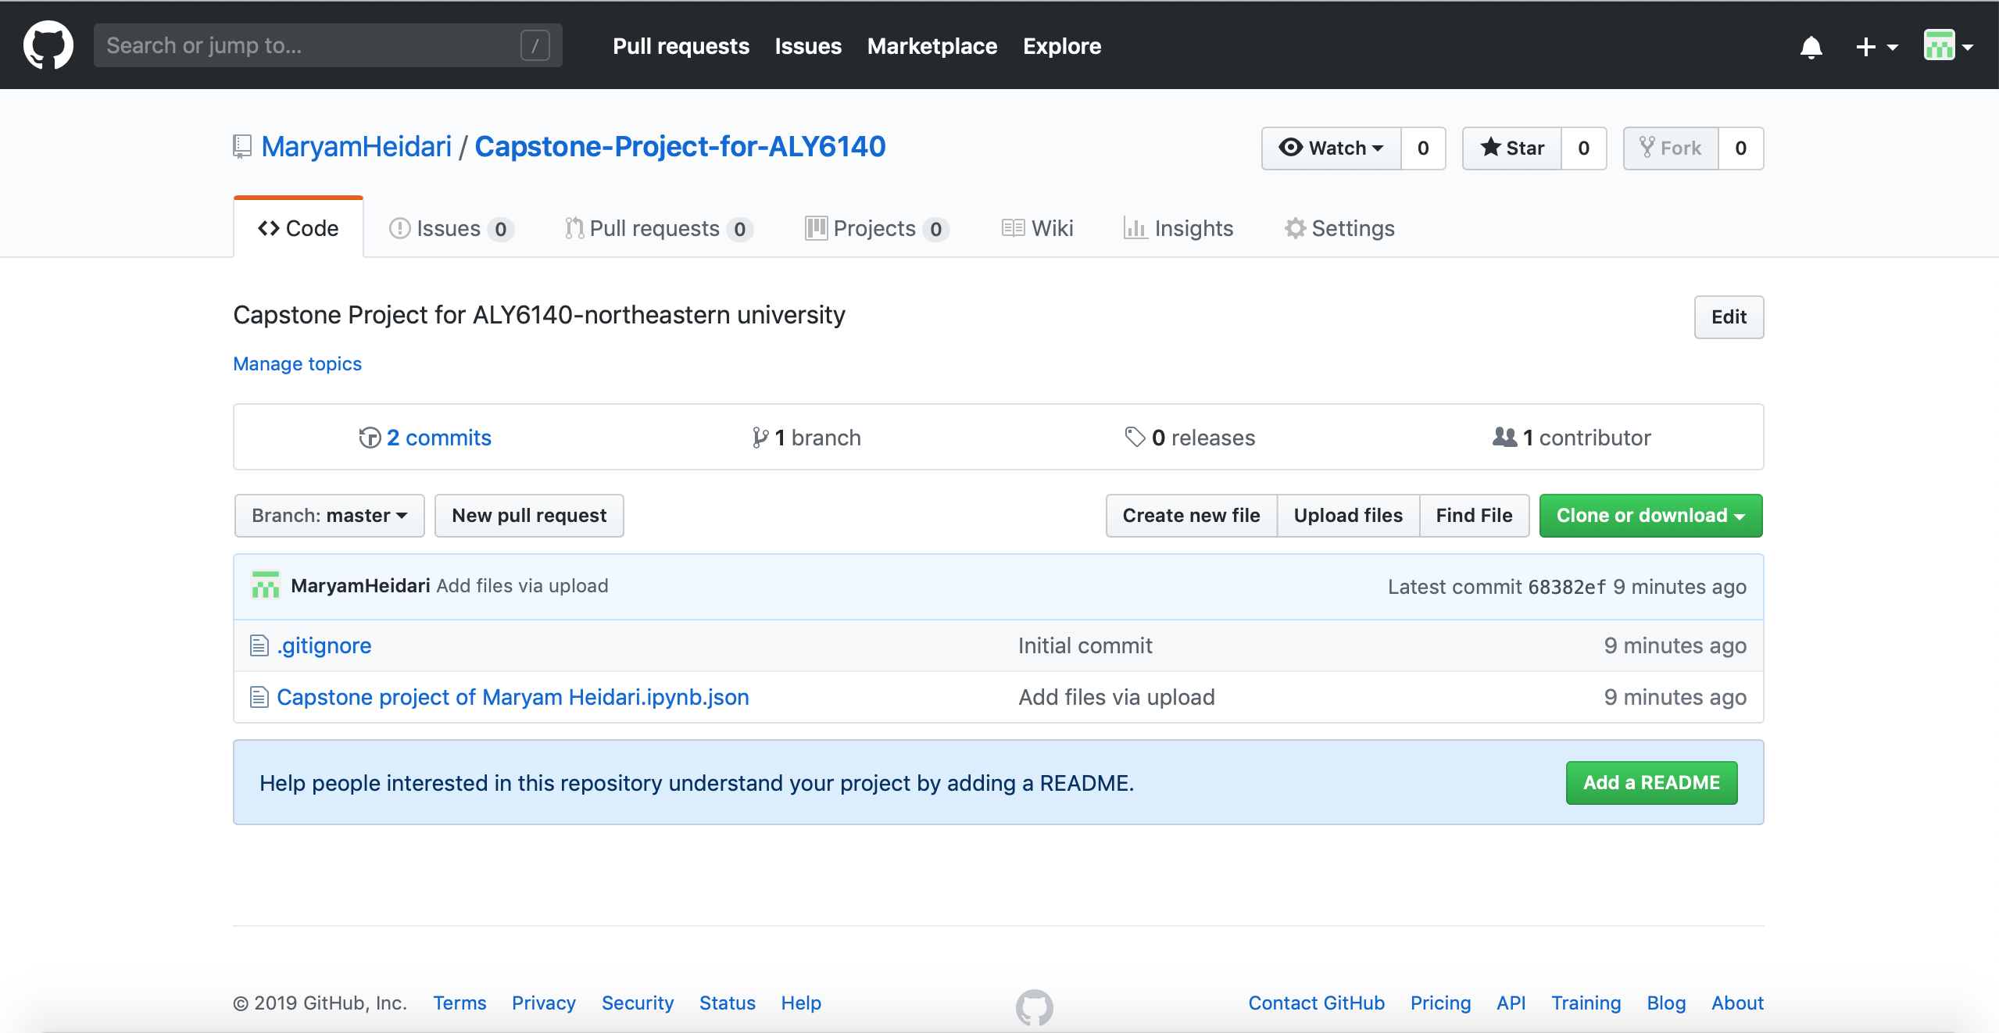
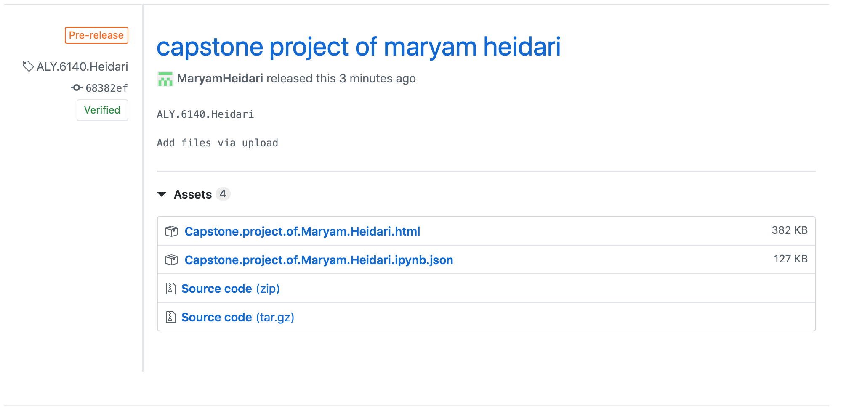
Github

Slide 17
Thank you so much for your attention

